Slide 1

Classification
Notes:
Instructor Name

Slide 2
Recap
Feature Engineering: Data cleaning and transformation
Data visualization using plots
Unsupervised learning: clustering using K-means
Supervised learning: Regression

Slide 3
Recap
We use machine learning algorithms to give our computers the ability to learn and improve from data
Our focus today is on supervised learning
A type of machine learning where we are given labeled data as an input and attempt to output the correct label
First, we will look at classification
When the label we are predicting is of a specific class
(As opposed to a real-valued number, for example)

Slide 4
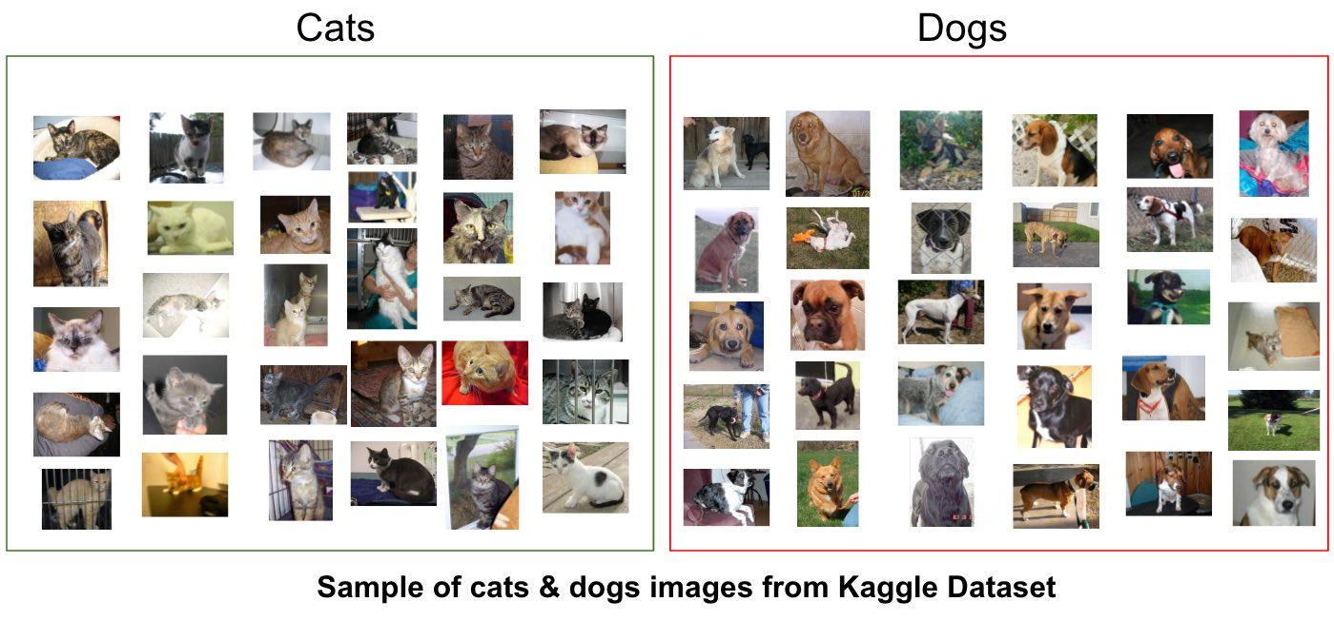
The Classification Task

Slide 5
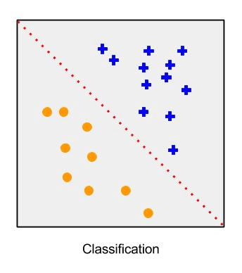
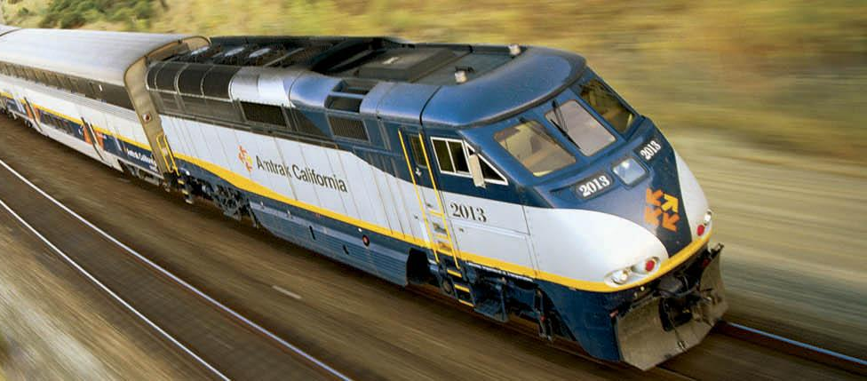
The Classification Task
Classification: A type of supervised learning problem where we want to determine what class each example belongs to
Given an image, classify if it contains a train in it
The examples are images
The classes are “train” or “no train”

Slide 6
Binary and Multiclass Classification
Binary Classification: When there are only two classes
Examples:
If a tweet mentions a disaster or not
If an image has a cat or not
Multinomial Classification: When there are many classes
Examples:
What genre of music is this song? (e.g. rock, rap, country)
What object is in this picture?

Slide 7
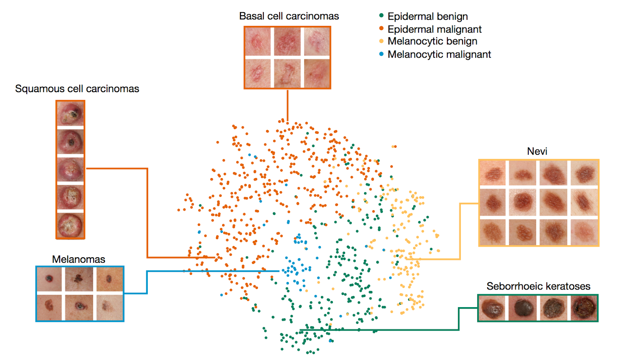
Multinomial Classification Application

Slide 8
General Approach to Classification
We want to build a model that assigns the correct class (label) to an example
The model is also known as a classifier
What we need:
Identify what the data type is (image? text?)
Identify what the classes (labels) will be
Identify what features we care about
Training Set: A dataset of already labelled examples

Slide 9
Activity: Feature Identification
We need to design a classification system that is able to predict if it would rain today or not.
Discuss the following:
Identify what the data type is (image? text?)
Identify what the classes (labels) will be
Identify if the system to be designed is binary or multiclass
Identify what features we care about
Identify the training set: A dataset of already labelled examples

Slide 10
Activity: Feature Identification
We need to design a classification system that is able to detect if a given image is a bike or not.
Discuss the following:
Identify what the data type is (image? text?)
Identify what the classes (labels) will be
Identify if the system to be designed is binary or multiclass
Identify what features we care about
Identify the training set: A dataset of already labelled examples

Slide 11
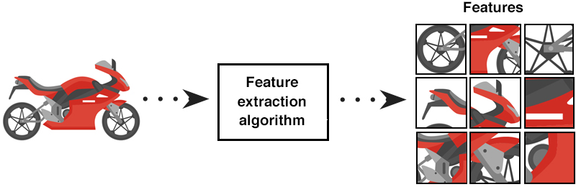

Slide 12
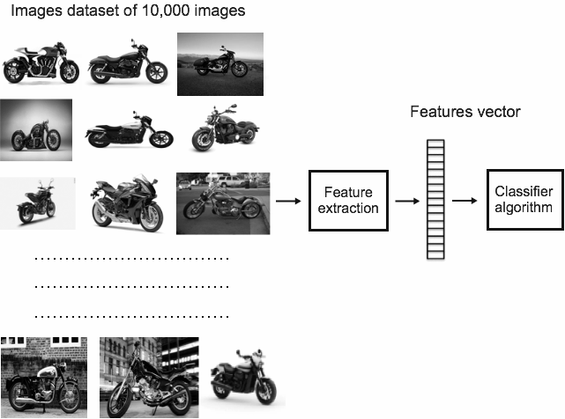

Slide 13
General Approach to Classification
Train our classifier on the training set
Run our classifier on new, unseen examples in the test set
Evaluate how our classifier performed
Modify and re-train our classifier to do better!

Slide 14
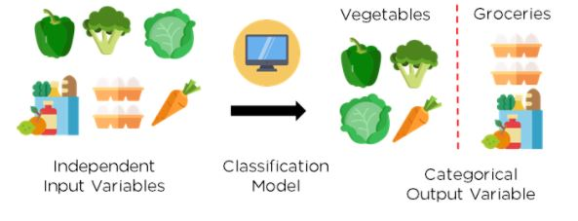
Classification Algorithms
Different classification algorithms will:
Make use of the training data in different ways
Make classification decisions in different ways
Make different assumptions about your data

Slide 15
DECISION TREES

Slide 16
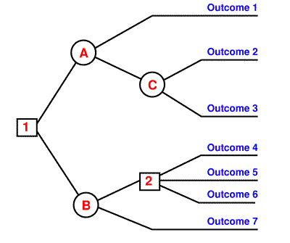
Decision Tree
An algorithm for classification that makes decisions by splitting up the training set based on specific features
When trying to decide how to classify an example, we will ask a series of questions (often yes/no questions)
Which questions we ask will depend on what the training set looks like

Slide 17
Decision Tree
By splitting up the possible outcomes at each question, we create a diagram that looks like a family tree
We call this a rule-based classifier because at each step, we follow a specific rule to make a decision
Decision trees make it very clear how we ended up at a certain conclusion because we can trace which questions we asked along the way

Slide 18
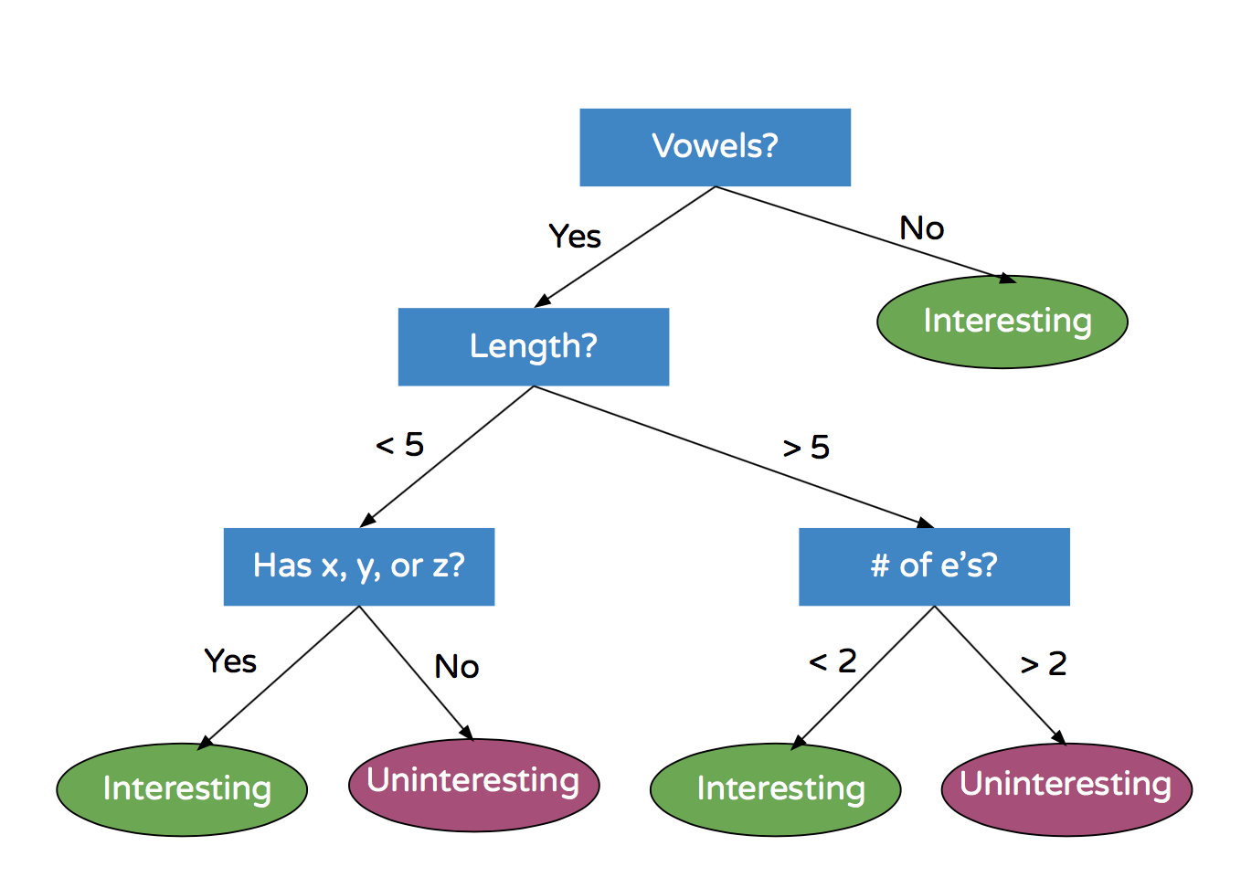
Example
How would we classify the following words according to this decision tree?
Rhythm
Abibliophobia
Emergence
Zen

Slide 19
Learning a Decision Tree
We saw how to follow a decision tree, but how do we build, or learn, it?
This is where Machine Learning comes in!
We use our training data to build a decision tree
We aim to build a decision tree that:
Classifies the examples in our training set correctly
Generalizes for unseen examples

Slide 20
Steps for learning decision trees
Look at all of your training data

Slide 21
Training Set
A
A
B
B
8 colored shapes
Group A or B
Learn a tree that classifies them best
A
B
B
A

Slide 22
Steps for learning decision trees
Look at all of your training data
Select the feature that gives the “best split”

Slide 23
Feature(s):
Green
Square
A
A
B
B
B
A
Label as group B
B
A
Continue to decide
An Inefficient Split

Slide 24
Feature(s):
Circle
B
A
B
A
B
A
Label as group A
B
A
Continue to decide
An Inefficient Split

Slide 25
Feature(s):
Blue
B
A
A
A
B
B
A
B
Label as group A
Continue to decide
A Much Better Split

Slide 26
Steps for learning decision trees
Look at all of your training data
Select the feature that gives the “best split”
Create a new node in the tree based on this split

Slide 27
Our Decision Tree So Far
Blue?
No
Yes
Still building
Still building

Slide 28
Steps for learning decision trees
Look at all of your training data
Select the feature that gives the “best split”
Create a new node in the tree based on this split
Separate your training data based on this split

Slide 29
Our Decision Tree So Far
Blue?
A
B
No
A
A
Yes
A
B
B
Still building
Still building
B

Slide 30
Steps for learning decision trees
Look at all of your training data
Select the feature that gives the “best split”
Create a new node in the tree based on this split
Separate your training data based on this split
For each group, repeat steps 2 to 4 until one of the following is met:
All examples in the group have the same class
The group has less than some number of examples
You’ve already split the tree a certain number of times
If met, create a child node that represents the class

Slide 31
Finding the Best Split
So how do we find the feature that gives us the best split?
One approach: find the split with the least classification error after the split
That is, if you were forced to make a classification for each of your groups after the split, how would you split your data so you get the most examples classified correctly?
We would do this for all of our features and compare to see which one gives the best split

Slide 32
Summary
A decision tree is a simple and fast way to do classification based on asking questions about one feature at a time
Very easy to understand why certain decisions are made
Easy to follow how the algorithm makes its classification decisions (not the case for more complex algorithms!)
Built by identifying “best splits” in the training data

Slide 33
RANDOM FOREST CLASSIFIER

Slide 34
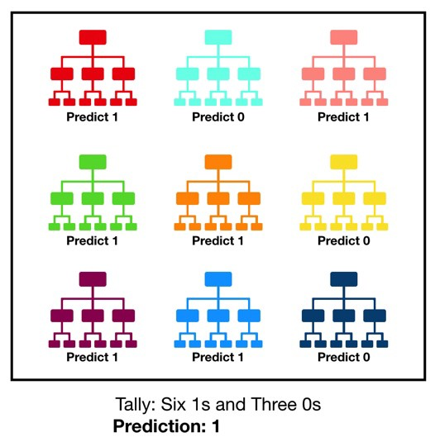
Random Forest Classifier
Random Forest is build on top of the Decision Trees.
It uses the principle of ‘The Wisdom of Crowds’.
The aggregate information from a group often leads to better decisions than any single member of the group.

Slide 35
Steps involved
We build several decision trees. For each decision tree we use a different subset of features and/or a different subset of the training set.
We save the predictions of each decision tree fitted.
The final predicted values from the Random Forest is based on this aggregate information. It usually takes what the majority of the decision trees voted as the final prediction.

Slide 36
Activity 2
Feature 1
Feature 2
Feature 3
No
Yes
No
Yes
No
Yes
Feature 2
Examples A, D, E
Feature 3
Examples B, C
No
Label = 1
No
Label = 1
Examples E, F, G
Examples
A, B, C, D
Yes
Yes
Label = 0
Label = 1
Examples F, G
Examples B, C
Examples E, F, G
Examples A, D
Label = 0
Label = 1
Label = 0
Label = 1
What would be the final label of each example (A, B, C, D, E, F, G, H)?

Slide 37
NEAREST NEIGHBORS

Slide 38
Nearest Neighbors
Relies on the assumption that similar examples should be classified the same
Examples are represented as points on a graph
Similarity is dependent on the distance to other examples on the graph
Simplest version: Give your new example the same classification of the “closest” training example

Slide 39
Examples as Points on a Graph
How do we go from examples to points on a graph?
Let’s take the task of classifying a skin image as cancerous or not
In order to go from the example (an image) to a mathematical point, we need to think about its features
We represent information about the image (its features) as its coordinates

Slide 40
Images to Points
For example, say we define each picture by two features: darkness and size
For any given picture, we can choose to express it mathematically as
(darkness, size)
So an example could be (0.5, 0.6), meaning darkness is 0.5 and size is 0.6

Slide 41
Nearest Neighbors Steps
Plot the labelled training set examples on a graph based on the features we have selected
When we’re given a new, unseen example, plot it on the graph based on its features
Compute the distance from the new example to all of our training examples
Assign the example a classification based on the classification of the closest example

Slide 42
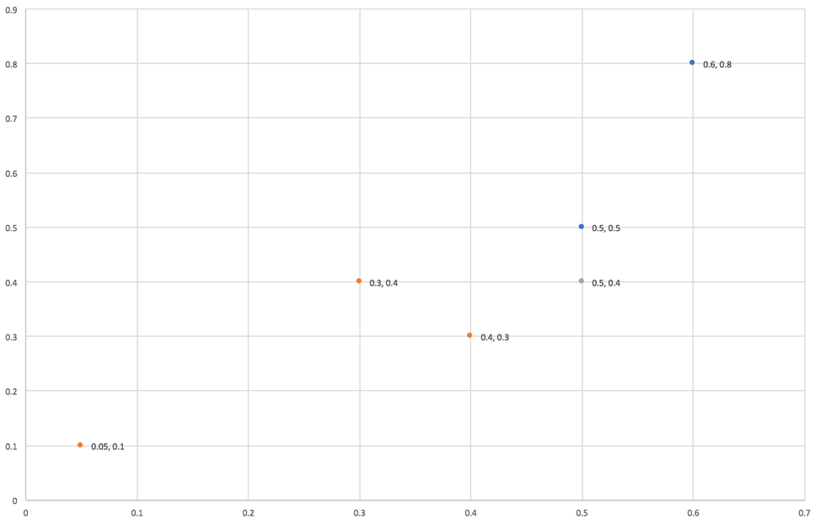
Nearest Neighbors Example
Let’s try to classify a new, unseen image!
We will classify the image with the label of the point closest to it
What do you think the classification will be?
Size
New example
Non-cancerous
Darkness
Cancerous

Slide 43
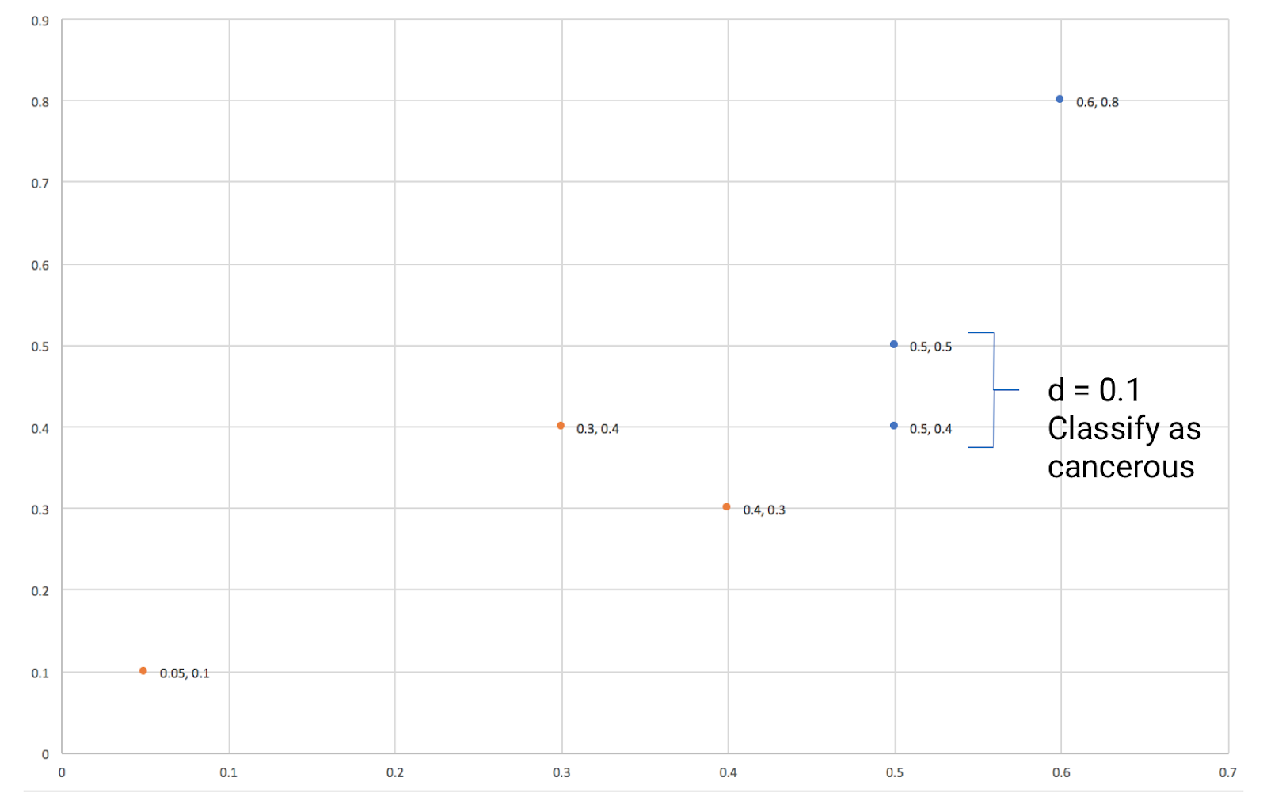
Nearest Neighbors Example
Size
New example
Non-cancerous
Cancerous
Darkness

Slide 44
K-Nearest Neighbors (KNN)
An extension of Nearest Neighbors
Instead of only looking at the one closest example, base your classification off the k nearest examples
More accurate for classification, because it looks for the majority classification among more examples
If there is a tie, base the classification off the k - 1 nearest examples
k is a parameter that we get to pick

Slide 45
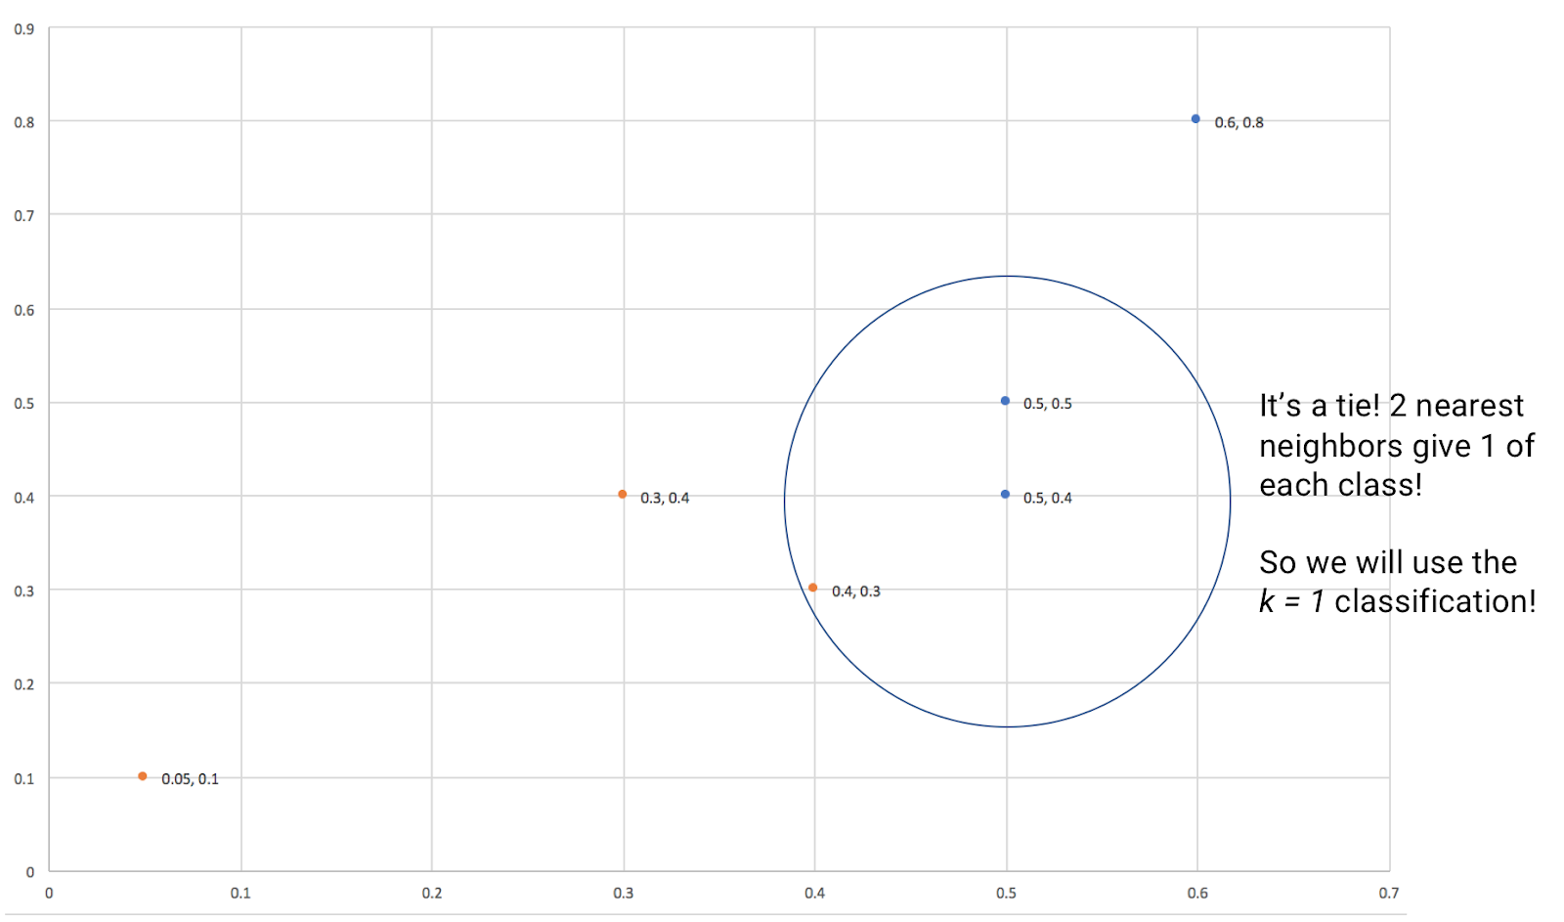
K-Nearest Neighbors Example
What if k = 2?
Size
New example
Non-cancerous
Cancerous
Darkness

Slide 46
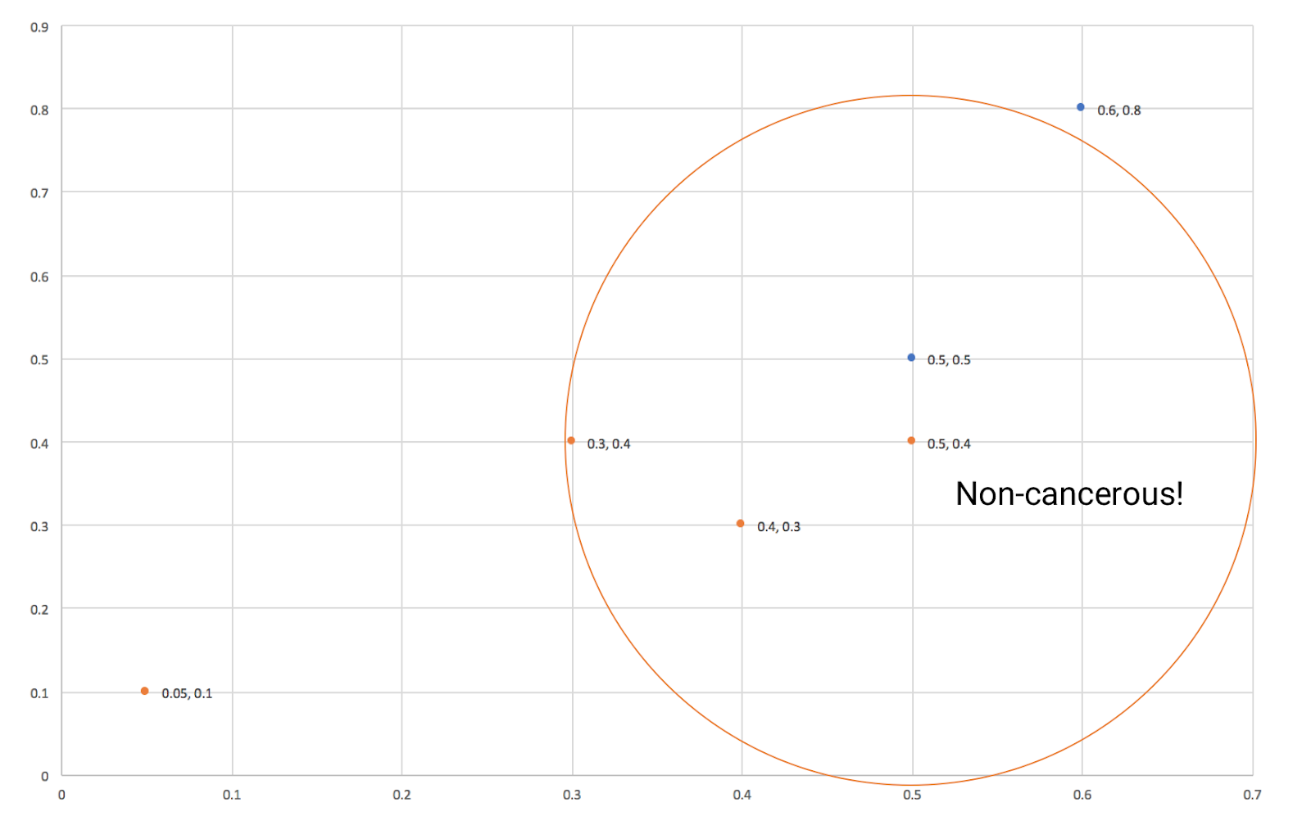
K-Nearest Neighbors Example
What if k = 3?
Size
New example
Non-cancerous
Cancerous
Darkness

Slide 47
Nearest Neighbors Summary
KNN is a simple algorithm that classifies based on distance
Depends on the idea that if an example is nearby, it should have a similar classification
We choose a single k to use on all examples
Given a whole set of unseen examples, you want to choose a k that makes the most examples classified correctly

Slide 48
SUPPORT VECTOR MACHINE

Slide 49
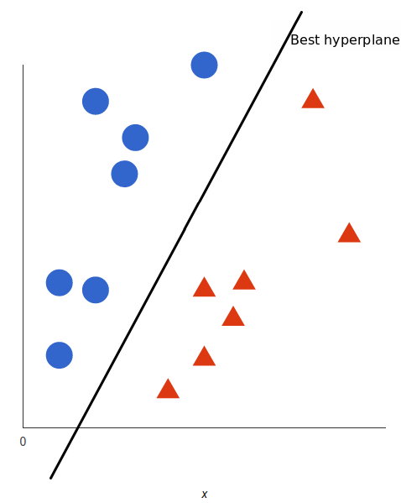
Support Vector Machine (SVM)
The SVM is a classifier that tries to build a hyperplane splitting the data points from different labels.
So the main task is to find the best hyperplane.
A good hyperplane maximizes the margins from both sides.

Slide 50
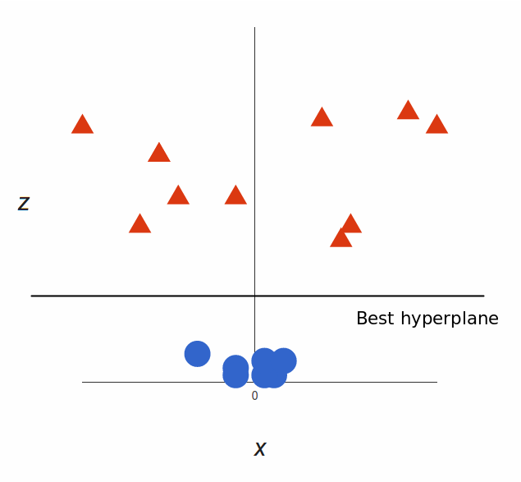
Support Vector Machine (SVM)
Up until now, we had two dimensions: x and y.
We create a new z dimension, and we rule that it be calculated a certain way that is convenient for us: z = x² + y² (you’ll notice that’s the equation for a circle).
With x and z we can easily find a hyperplane.

